Slide 1
Machine learning in python
From 1 to 80 Real quick
By CoadBros, 2018
Josiah COad

Slide 2
Introduction
What you’ll walk away from here with (from past students)
How the basic of neural nets work
Get your hands dirty with some of the software tools in data science and machine learning
A rough guide to how machine learning works
How to implement neural networks in Python
Forward-Backward propagation
“I learned enough to begin practicing to set up a basic neural network.”
Getting an overall understanding of what machine learning is and how it works

Slide 3
Machine Learning
“Machine learning is based on algorithms that can learn from data without relying on rules-based programming.”- McKinsey & Co.
Algorithm 2 – Machine Learning Based
past_data =
[(8, 10, “A”), (5, 10, “B”), (6, 12, “B”) …]
def predict_grade(past_data, hrs_slept , hrs_studied):
threshold_slept = randomint()
threshold_studied = randomint()
# iterate through your past_data, trying to
# find the perfect thresholds that most
# accurately predicts your outcome grade.
# finally, predict the grade given the threshold
# AKA parameters that you learned.
Algorithm 1 – Rule Based, Classical AI
def predict_grade(hrs_slept, hrs_studied):
if hrs_slept > 7 and hrs_studied > 10:
return “A”
elif hrs_slept > 5 and hrs_studied > 10:
return “B”
elif hrs_slept > 5 and hrs_studied > 5:
return “C”
…

Slide 4
WhERE Does this LECUTRE fit in to the big picture?
Artificial Intelligence
Feed Forward Neural Network
Machine Learning
Neural Networks
Supervised Machine Learning
Artificial Intelligence is a branch of computer science dealing with the simulation of intelligent behavior in computers
Machine learning is an application of artificial intelligence (AI) that provides systems the ability to automatically learn and improve from experience without being explicitly programmed. Machine learning focuses on the development of computer programs that can access data and use to learn for themselves.
Supervised learning is the task of learning from labeled training data. The labeled training data is used to fine tune the model to make more accurate predictions by minimalizing error.
A Densely Connected Feed Forward Neural Network is one type of supervised machine learning that we will learn about in this class used to predict values and classify data. More on this in the slides to come!

Slide 5

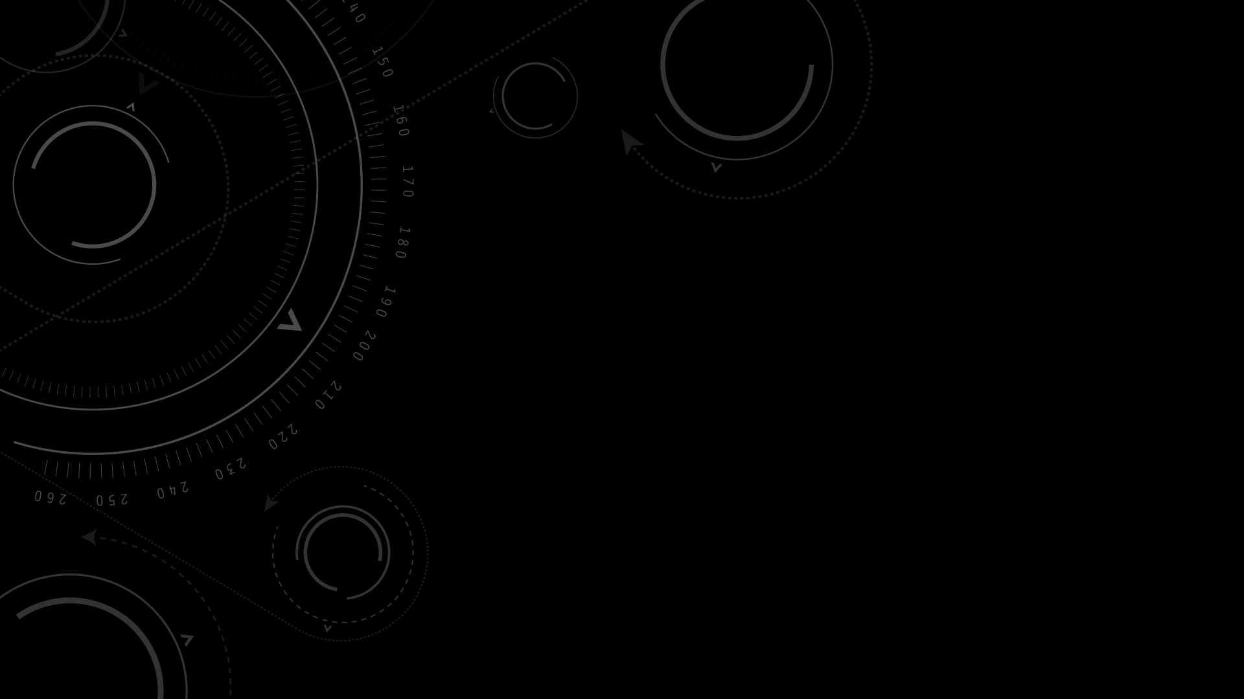
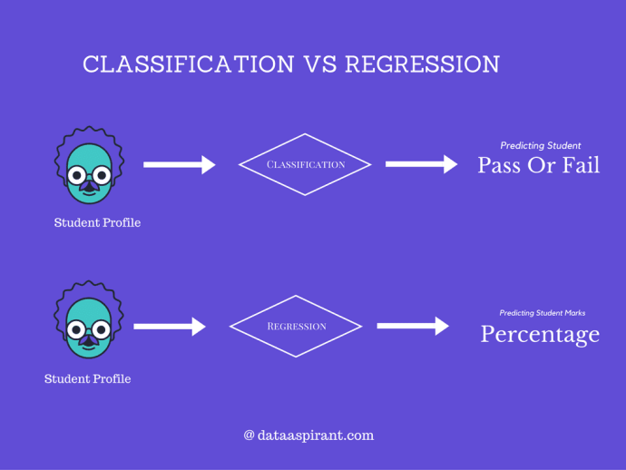
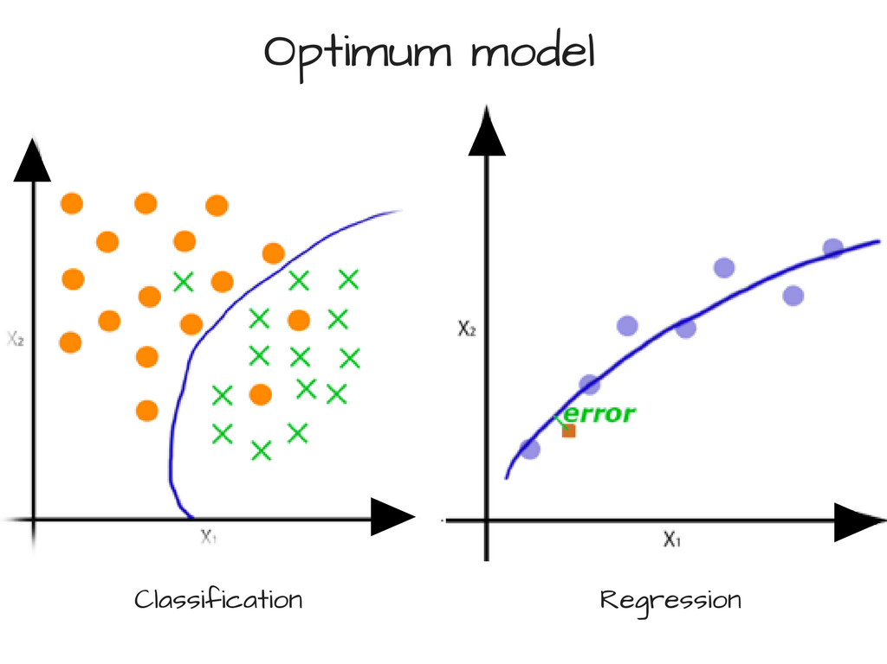
Classification versus Regression
Called a decision boundary →

Slide 6
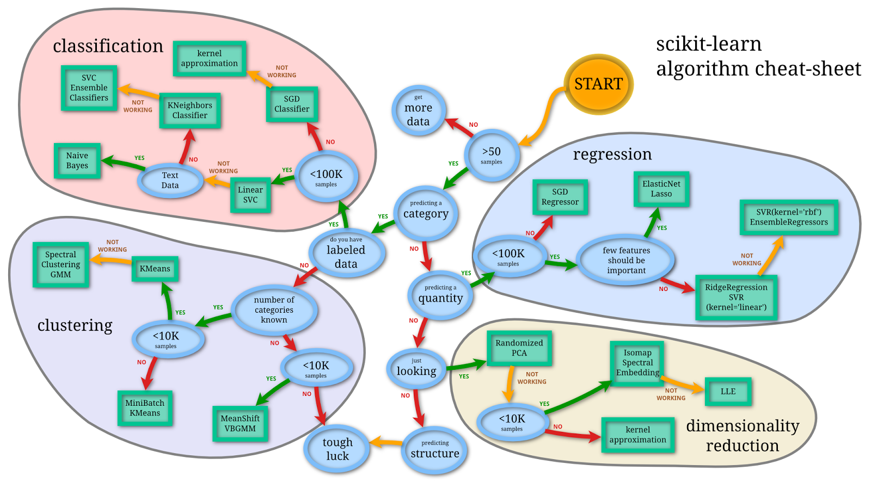
When to Use a Neural Network? (Here called a SGD Classifier/Regressor)

Slide 7
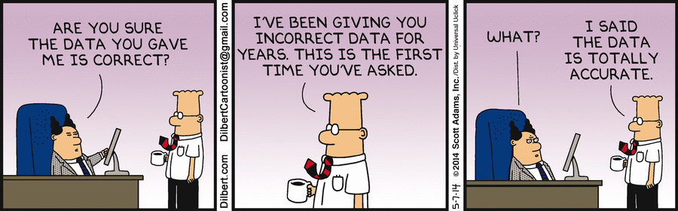
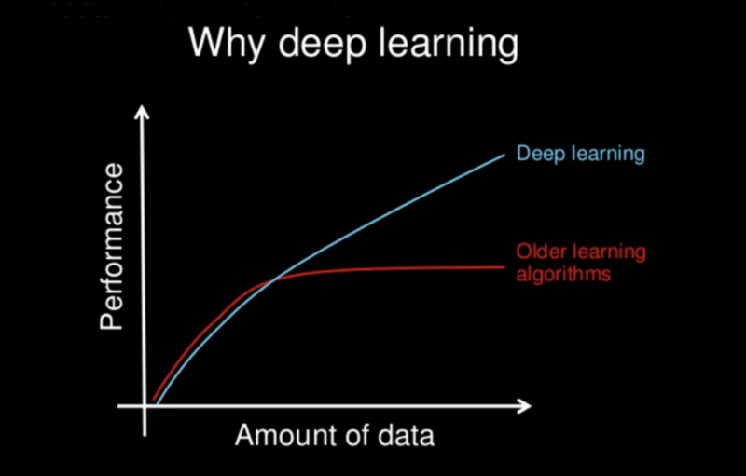
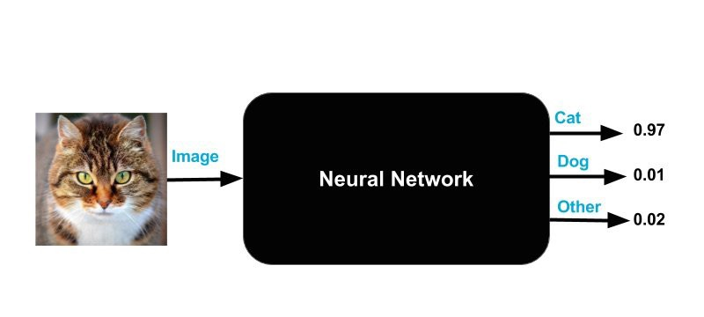
When to use a neural network (CONT)
You’ve still have got to
understand your data!
Lots of data ( >100K* for good results )
Black Box: Why did it do that?

Slide 8
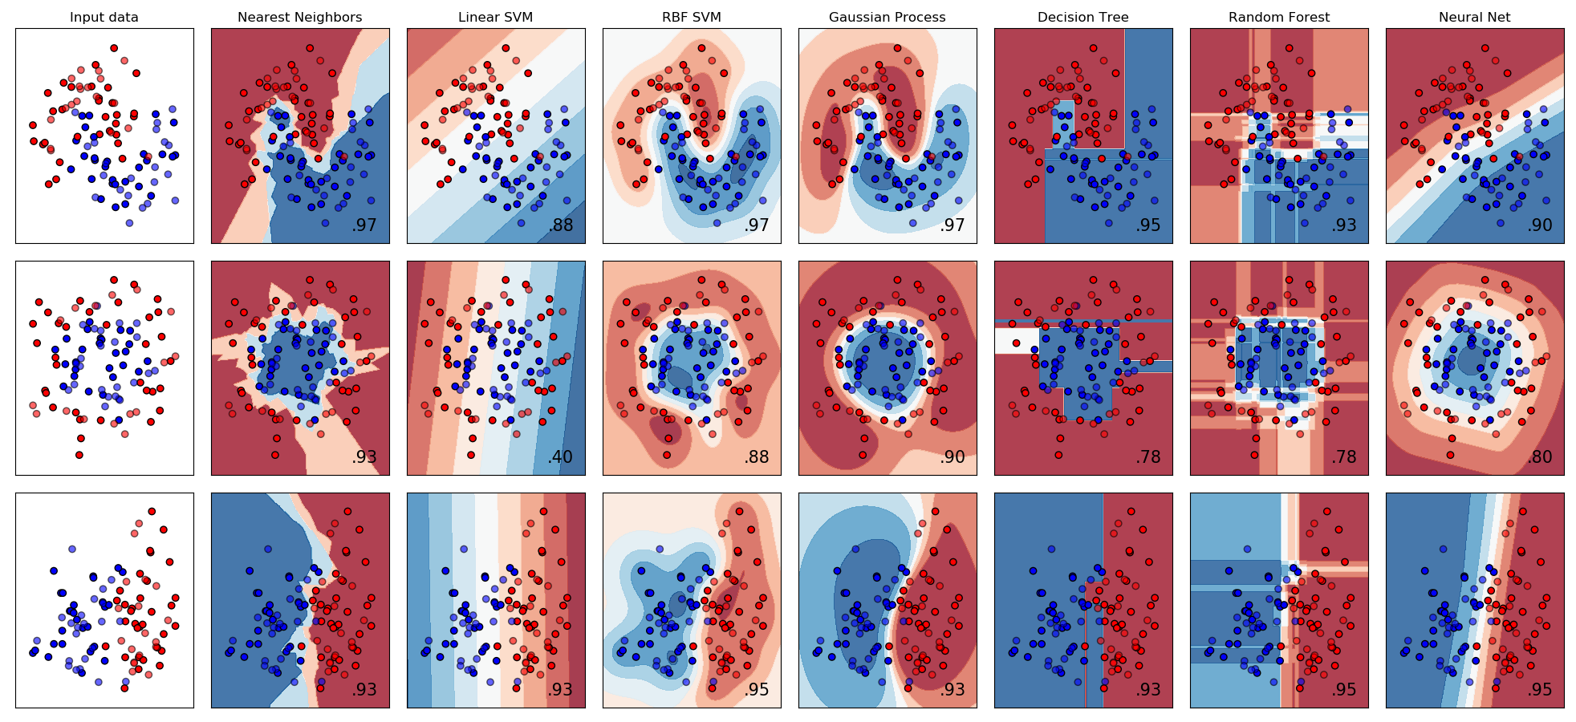
How different models make decision boundaries for classification.

Slide 9
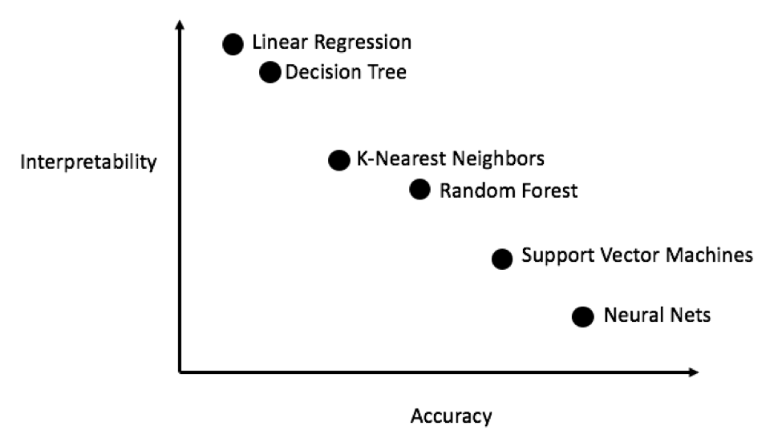

Slide 10
INTRODUCTION RECAP
Ockham's Razor: Simplest Is best. Always use the simplest method you can find – this stuff can get complicated!
Feed Forward Fully Connected Neural Networks are a very specific type of machine learning model which can be used for classification (predicting classes) and regression (predicting values)
Trade-off between (complex) predictive ability and (simple) interpretability. Neural Networks are highly accurate but have very low interpretability.
Machine learning discovers complex patterns in your data by a trial-error iterative process. (For a neural networks, this trial-error process is called forward and backward propagation)

Slide 11
Chapter 1: How A neural network MAKES A (NON-LINEAR) PREDICTION
Key Terms
Edge Weight
Node / Multilayer-perceptron
Hidden Layers
Input Layer, Output Layer
Forward Propagation
Activation Functions
Fully Connected, Feed Forward
sklearn.neural_network.MLPRegressor(
hidden_layer_sizes=(100, ),
activation=‘relu’,
solver=‘sgd’,
batch_size=10,
learning_rate_init=0.001,
early_stopping=False,
validation_fraction=0.1)

Slide 12
a Forward propagation Network
This is called a densely connected network since every node is connected to the node in the next layer.
Input Layer: #nodes = #input predictors we have
Edge Weight
Hidden Layer
Output Layer:
#nodes =
1 if regression
#classes if classification
8
-1
7
hr. slept
-2
3
4
1
5
18
1
Test grade
hr. studied
2
Node value = ∑ (weights * incoming values)
Weights initialized randomly.
Weights change to get better predictions using backward propagation (coming next)

Slide 13
Activation Functions
Top: ReLu (Used in this course).
Bottom: tanh (Also popular).
Applied to the value of each node after “node value” has been calculated
Used to capture nonlinearities in data (ex: will 0 to 8 hours of sleep have the same effect as 8 to 16?). An activation function gives the model the ability to use nonlinearities like these.
Each layer gets an activation function. You can play around with different functions for different layers.

Slide 14
Example with a Relu activation function
Input Layer
Hidden Layer
Output Layer
Edge Weight
hr. slept
8
1
-7
ƒ: 0
-3
-2
18
1
5
ƒ: 18
1
Test grade
hr. studied
2
18
Node value = ∑ (weights * incoming values)
With the RELU activation function applied the hidden nodes, a negative node value outputs 0

Slide 15
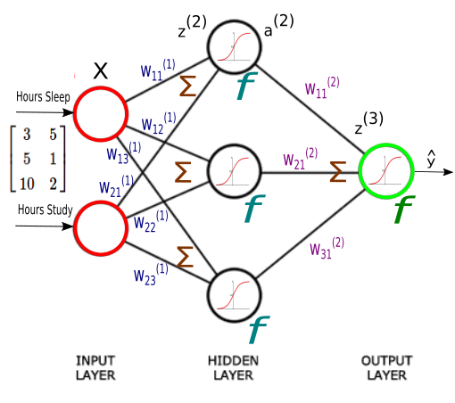
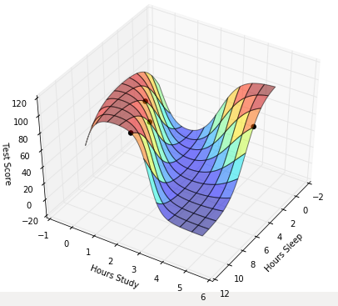
Test Grade Example
From BogoToBogo

Slide 16
adding layers
Adding more layers gives the neural network the chance to learn more complex relationships in the data faster* (research still going on in this)
Adding more layers doesn’t change the math of what we learned. The forward propagation just gets applied sequentially from the first layer to the last.
Input Layer
Hidden Layers
Edge Weight
Output Layer
hr. slept
8
1
-7
ƒ: 0
-2
ƒ: 0
-32
1
-3
-2
18
1
3
1
5
Test grade
hr. studied
2
18
ƒ: 18
1
18
ƒ: 18
Node value = ∑ (weights * incoming values)

Slide 17
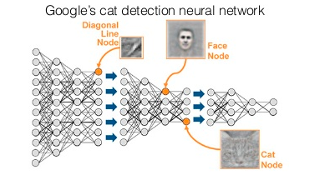
On a side note: Deep learning
A deep neural network has the ability to capture complex relationships with many layers like how a combination of pixels (low level representation of data) can be understood as an object (high level understanding of data) with many layers.

Slide 18
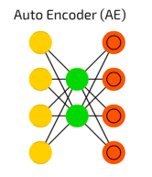
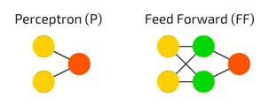
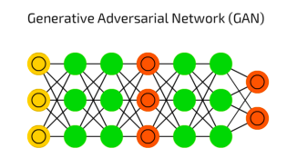
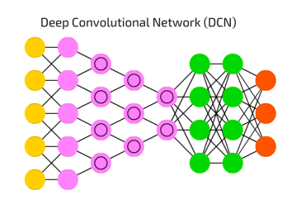
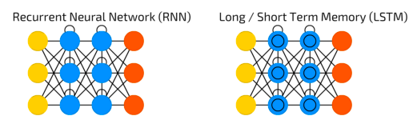
What ARE NEURAL NETWORKS USED FOR?
CNN/DCN: Used for dimension reduction and content generation.
Taken from: The mostly complete chart of Neural Networks, explained
P and FF: Building blocks of all deep learning. Still used for predicting values and classification from complex data sets
GANs: Built on game theory, used to generate content and “play against itself” to make itself better with no more data.
CNN/DCN: Used for image processing and recognition.
RNN (e.g. LSTM): Used for data that has correlation from one point to the next. i.e. natural language processing and video understanding.

Slide 19
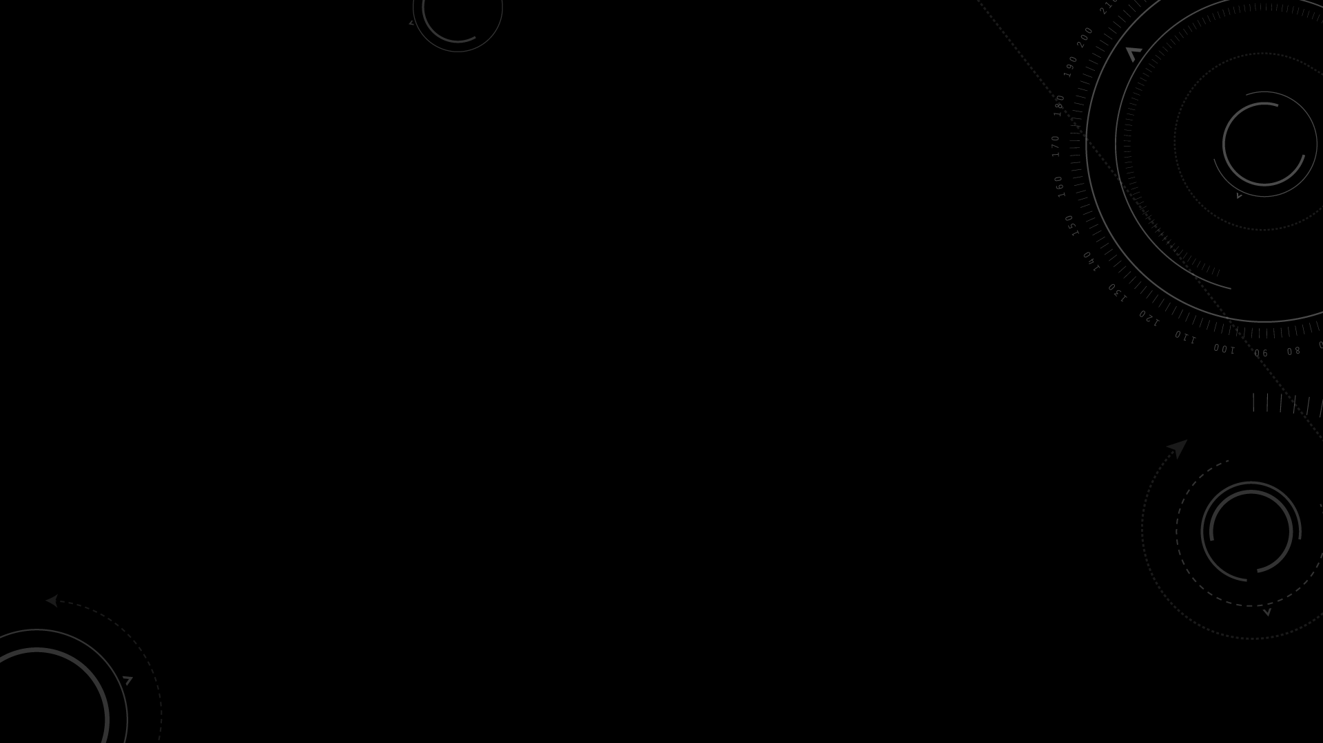
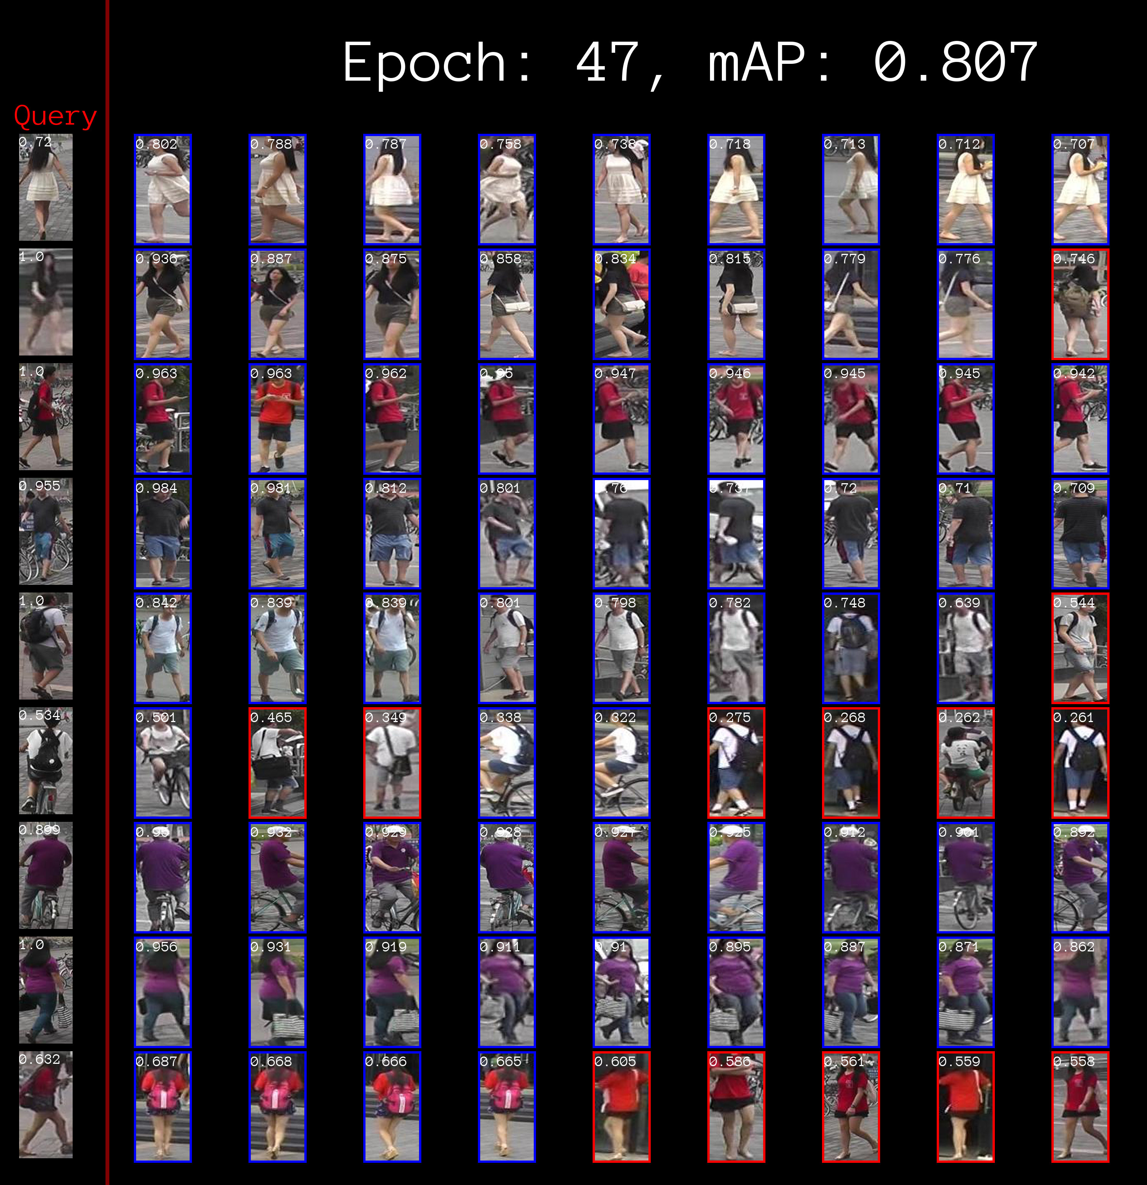
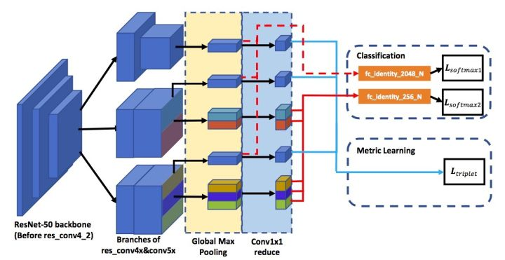
Person Reidentification

Slide 20
Chapter 1 Recap How A neural network MAKES A (NON-LINEAR) PREDICTION
Key Terms
Edge Weight
Node
Layer: Input Layer, Hidden Layers, Output Layer
Forward Propagation
Activation Functions
Fully Connected, Feed Forward

Slide 21
Chapter 1 Recap Cont. How A neural network MAKES A (NON-LINEAR) PREDICTION
Common Questions
How many nodes per layer should we have?
How many layers should we have?
Recall Ockham's razor: simplest is best – you don’t want to over fit!!
Start with a single hidden layer with a few nodes, then asses model performance
Keep adding more neurons as long as your model accuracy increases
When accuracy stops increasing very much, add another layer and see if that improves
Point: Simpler is better so start simple and increase complexity as needed
What activation functions should I use?
ReLU is good for most regressions (start here, change if you have reason to)
Tanh is good for classifications (note how it maps all outputs between 0 and 1)

Slide 22
Chapter 2: Optimizing/ “Learning” A MACHINE LEARNING MODEL
Key Terms
Loss Function
Gradient Descent
Learning Rate
Batch Size
Back-propagation
sklearn.neural_network.MLPRegressor(
hidden_layer_sizes=(100, ),
activation=‘relu’,
solver=‘sgd’,
batch_size=10,
learning_rate_init=0.001,
early_stopping=False,
validation_fraction=0.1)

Slide 23
Loss Functions: Minimizing Error In prediction
In linear regression, your goal is to draw a line through your data so that your line best “approximates” your data. AKA your line minimizes the total loss between your prediction and the data. Simple Linear Regression does this via mean squared error.
Mean Squared Error tells you how far your prediction (in this case a straight line) is from predicting you data. MEAN is so that you find the best possible fit for all your data. SQUARED is so that error is always positive and further away has more weight (formally this is a mean of the L2 distances)
MSE is an example of a LOSS FUNCTION: a way for your model to access its accuracy, AKA how far off it was. In the end, the model’s goal is simply an optimization problem: Minimize the loss!
Note: Also called an objective function.

Slide 24
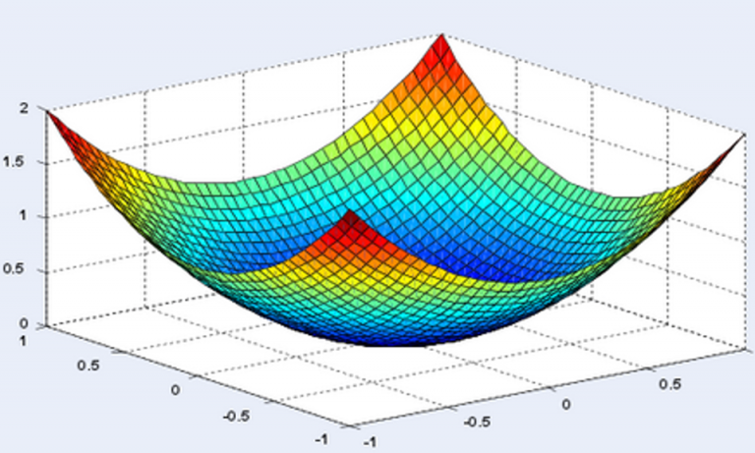
More on Optimization
← Convex Optimization: The loss function’s global minimal is the local minimal:
Much easier. Immediate minimization by finding the coefficients which sets first derivate of loss function = 0.
Derivation of Linear Regression
← Non-convex Optimization
Much harder… but more common with more complex models.
Many local optimals. How do we converge to a good one?
When we have many parameters such that decreasing the loss along one parameter increases it along another axis.
What we will focus on.

Slide 25
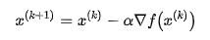
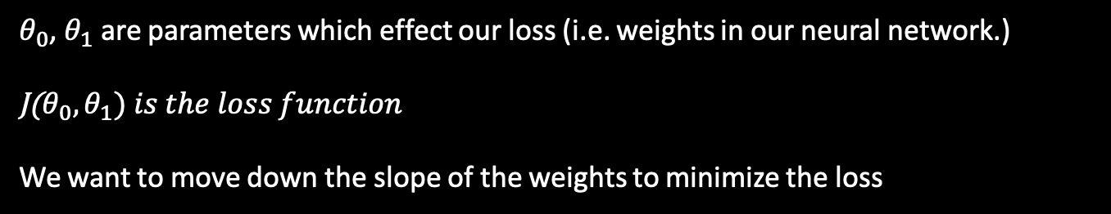
Gradient Descent
The process/algorithm by which we update the parameters to minimize the error.
Gradient: A collection of slopes
Decent: Moving down a slope
Gradient Decent: Moving down a collection of slopes (to minimize error)
Gradient Decent moves a “little bit” in the direction that minimizes loss.
Why not just move all the way?
Gradient Descent Wikipedia
$θ_{0}$, $θ_{1}$ are parameters which effect our loss (i.e. weights in our neural network.)
J($θ_{0},θ_{1}) is the loss function$
We want to move down the slope of the weights to minimize the loss

Slide 26
Learning rate
That “little bit” that we move in the direction of to minimize error.
An industry common learning rate is 0.01
Later we’ll learn about optimizers which find the optimal learning rate for you.
Too big of a learning rate will overshoot your loss-function minimum and your loss may “bounce around” and not converge to a min.
Too small may make your machine learning take too long to learn.

Slide 27
Batch Size
A batch is a subset of your overall data that you feed through your model before calculating your loss and adjusting your weights.
Why not just feed one data point through at a time? Why not feed it all through?
The rule of thumb is the more noise you think there is in your data, the bigger your batch size should be.
Batch size – is a concept of “stochastic gradient decent” where our walk towards a minimal is like a drunk person stumbling towards a goal.

Slide 28
Chapter 2.B: Optimizing/ “Learning” A NEURAL NETWORK MODEL
Gradient Descent In a Neural Network
Backpropagation (more than one layer)

Slide 29
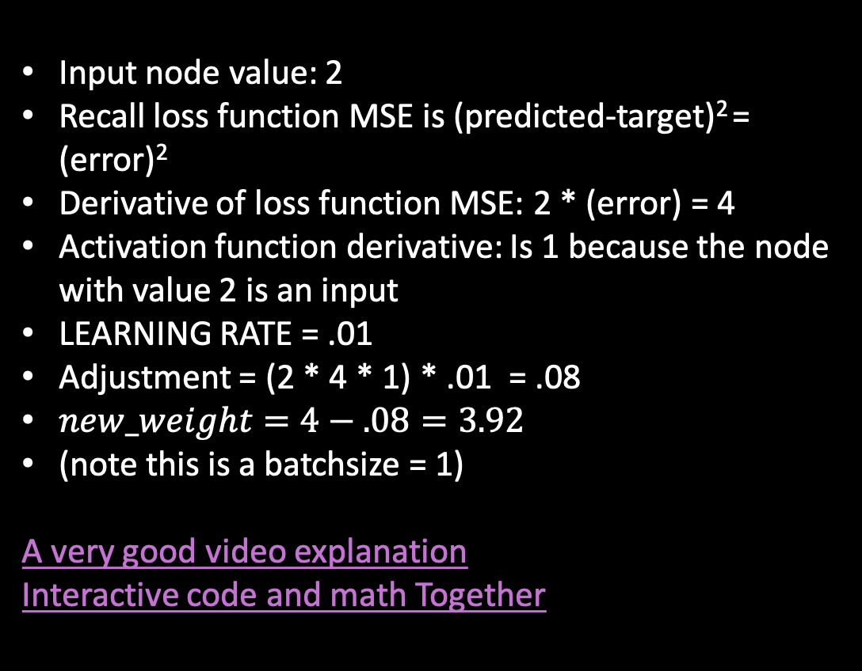
SIMPLE Example OF GRADIENT DESCENT
Input Node
Output Node
w = 3.92
2
w = 4
8
Predicted value: 8
Predicted value: 7.84
Input node value: 2
Recall loss function MSE is (predicted-target)² = (error)²
Derivative of loss function MSE: 2 * (error) = 4
Activation function derivative: Is 1 because the node with value 2 is an input
LEARNING RATE = .01
Adjustment = (2 * 4 * 1) * .01 = .08
$new_weight=4−.08=3.92$
(note this is a batchsize = 1)
A very good video explanation
Interactive code and math Together
Target value: 6
Error: 2
Error: 1.84
A graph of multiple iterations of gradient decent to adjust weights… see how the predictions get closer to the expected over iterations

Slide 30
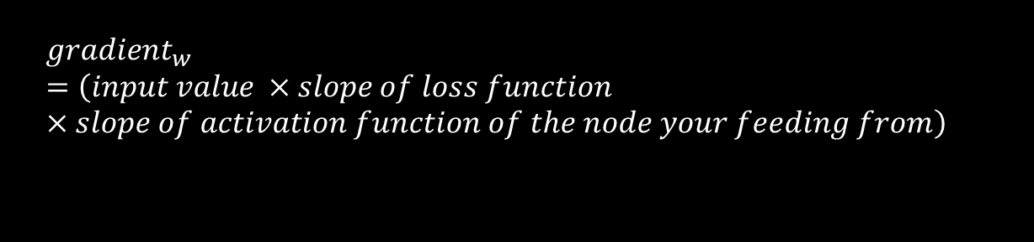
Expanding to Multiple Layers (Backpropagation)
Assume each hidden layer has the ReLu activation function and batchsize = 1.
G1 = 0
G-2 = 0
8
1
G-2 = input * 2 * Error * slope of activation * LR
hr. slept
-7
ƒ: 0
-3
-2
G-3 = 0
74
8
Test grade predicted value
9.42
G8 = -1.42
1
5
ƒ: 74
9.88
hr. studied
2
74
2.88
G1 = -8.88
G1 = 74 * 2 * Error * 1 * LR
G1 = -888 * LR
Error = (74-80) = -6
G2 = 5 * 2 * Error * 1 (no activation function for input) * LR
G2 = -88.8 * LR
G2 = -0.888
G2 = 5 * 2 * -8.88 * LR
Test Grade Target Value: 80
$${gradient}_{w}=\left(input value ×slope of loss function×slope of activation function of the node your feeding from\right)$$
Learning Rate = .01
New Weight = old weight - gradient

Slide 31
Chapter 2: Optimizing/ “Learning” A MACHINE LEARNING MODEL
Key Terms
Loss Function
Gradient Descent
Learning Rate
Batch Size
Back-propagation
sklearn.neural_network.MLPRegressor(
hidden_layer_sizes=(100, ),
activation=‘relu’,
solver=‘sgd’,
batch_size=10,
learning_rate_init=0.001,
early_stopping=False,
validation_fraction=0.1)

Slide 32
Chapter 3: OVERFITTING AND WHEN TO STOP Training
Key Terms
Validation Set
Test Set
Overfitting
Early Stopping
sklearn.neural_network.MLPRegressor(
hidden_layer_sizes=(100, ),
activation=‘relu’,
solver=‘sgd’,
batch_size=10,
learning_rate_init=0.001,
early_stopping=False,
validation_fraction=0.1)

Slide 33
Validation Set
Why do we take tests during a course? To validate that we are learning the material, right? If we do poorly on our midterms, we may rethink how we learn.
Your midterm will consist of problems that look similar to the practice problems but are slightly different. If you learned the underlying concepts, you will generalize well to the new problems and the midterm validates that you are learning well.
However, if you studied the practice problems so specifically that you become only good at those problems, you may not do so well on new problems. This is overfitting.
The goal then is to keep some “problems” (e.g. data) from the machine learning model and see how well it can do on them during the training. That’s a validation set!

Slide 34
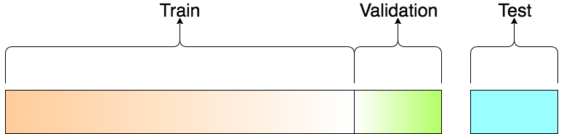
Test Set
Well we talked about “midterms”. Those are for you to validate that you are learning well. But you still have a final to your course, right? This is the test at the end once you’re done learning, that you actually learned the material, and you’re now a pro!
The test set should be data never seen before in any of the training process. Only at the very end do you use it see how well your model does on the test set

Slide 35
Problems with overfitting
Overfitting a regression model by capturing the noise more-so than the underlying trend.
A model can over-fit some training data by becoming “too good” at understanding the training data so that its not learning the underlying trend.
How can a model over-fit?
Increasing nodes or layers to the network increases model complexity.
Running more epochs also can over fit your data.
* epochs is the number of times your model runs through the entire training set (e.g. iterations)
Overfitting a classification model by again capturing the noise more so then general trend.

Slide 36
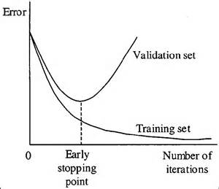
Early Stopping
You can know overfitting is happening when your training loss keeps decreasing but your validation loss starts increasing!
Early stopping will terminate training when validation score is not improving (or starts getting worse)!
“Patience” or “n_iter_no_change” in sklearn is the number of iterations we are allowed to keep going without seeing any progress in the validation loss.

Slide 37

What to do to improve performance
Data
Regularization – data on same scale?
Randomization – look at your batches – are they sufficiently random and evenly represent your overall population?
Training/test split. Does it represent the same distribution for all your predictor variables? Visualize your data!
Data has too much noise? Visualize your data!
Class imbalance? Do you have enough examples of both classes?
Enough training examples? Curse of dimensionality.
Network
Add methods to avoid overfitting: regularization and dropout
More ways to improve your model

Slide 38
Implementing Neural Networks At four levels of depth
Novice: SkLearn (you do that here!)
Intermediate: Keras
Master: TensorFlow
Superhuman: Implimenting From Scratch

Slide 39
Tensor Flow Playground
Using playground.tensorflow.org
Try setting noise to max and batch size small. See how it jumps around a lot more!
Try setting the learning rate above 1 and see how much it jumps around, and how it over fits, and how thick (which means large valued) the weights get! Now try adding regularization. See how that counteracts those problems.
Try adding more nodes/layers using the method we proposed earlier.
Hover over each node and edge and really try to understand how the whole thing is working. Nearly everything there was explained in these slides so it’s a great way to test your knowledge.

Slide 40
Quiz Time!
Please go to https://goo.gl/forms/GwW6zt1TakWEa0Tm1

